Slide 1


Everything you need to know
about giving blood!

Slide 2


About Welsh Blood
Every Year…
1,600
Donation Clinics
400
Venues
100,000
Donations taken
75% South Wales
25% North Wales

Slide 3
Why donate?
75%
Medical conditions
20%
Surgery
5%
Childbirth
Everyday we need around 350 donations to support our 19 hospitals in Wales.
Notes:
From the blood donations received in Wales, around 75% go to treating medical conditions, 20% go to surgeries and 5% go to mothers and babies during childbirth.
To keep a steady supply of donations, the Welsh Blood Service needs around 350 donations every day to support the 19 hospitals it supplies in Wales.

Slide 4
How many people donate?
What percentage of eligible people living in Wales give blood?
a) One percent
c) Five percent
b) Three percent
d) Ten percent

Slide 5
How many people donate?
What percentage of eligible people living in Wales give blood?
a) One percent
c) Five percent
b) Three percent
d) Ten percent
Notes:
Three percent of the eligible population currently give blood, whilst this normally covers the need from hospitals. New donors are always encouraged.

Slide 6
What’s in a donation?
Red cells
Platelets
Plasma
Last 35 days
Last 7 days
Lasts for 2 years
A&E
Cancers
Heavy burns
Notes:
Every blood donation can be split into three components: red cells, platelets and plasma. Each component has a different shelf life, and a different use for helping patients in need.
Red cells last 35 days and help replace blood loss, such as helping patients in A&E or helping mothers and babies during childbirth.
Platelets last just 7 days and help as part of treatment for cancer patients whilst receiving chemotherapy treatment.
Plasma can be frozen and stored for up to two years which can be used to help patients following heavy burns.

Slide 7
What’s My Type?
You will have one of four different blood types and each type has a positive and negative.
A
AB
B
O

Slide 8
What’s My Type?
O negative is the universal blood type.
Anyone in this room can receive O- blood which makes it crucial for emergencies.
O
Notes:
Although you may not know your own blood type – if you gave blood the Welsh Blood Service would be able to tell you your type if you donate blood.
You don’t need to know your blood type in order to give blood.

Slide 9


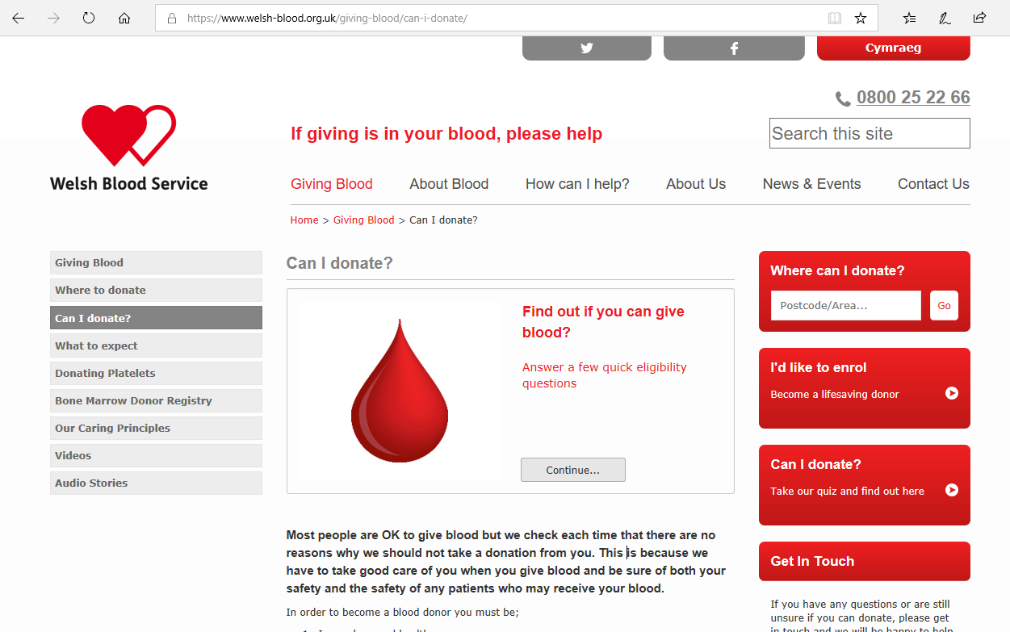

Top tips before giving blood
Eat well
Check you
can give
Stay hydrated
Notes:
Top tips if you want to give blood.
Go online: welshblood.org.uk and check your eligibility to donate using the handy Welsh Blood Service quiz.
Eating well and staying hydrated before a donation is important. You’ll also be given water to drink when you arrive on the day of donation.

Slide 10



What you need to know
The whole process takes up to one hour.
Donating only takes five to ten minutes.
No time limit on the tea and biscuits.

Slide 11











What might stop you donating?
Possible deferral
Four month deferral
On the day
Meds/
conditions
Piercings
Feeling unwell
Weight
Tattoos
Not drinking
Travel
Microblading
Not eating
Dental
treatment
Lip fillers etc.
16
Aged 17+
Notes:
If you have any specific questions, find the Welsh Blood Service on social media or call 0800 252 266.

Slide 12
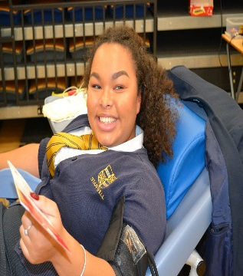
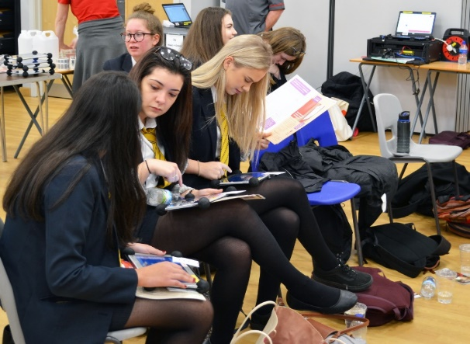

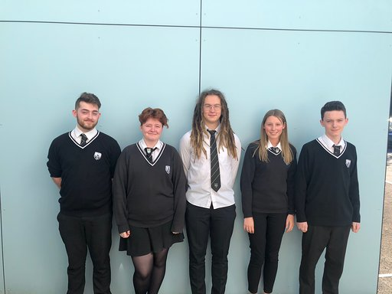
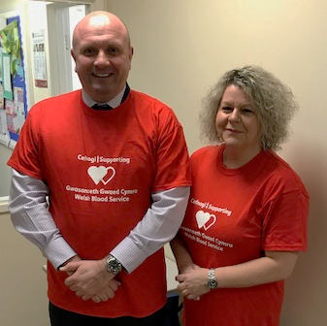
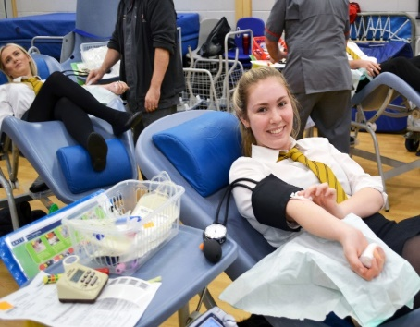
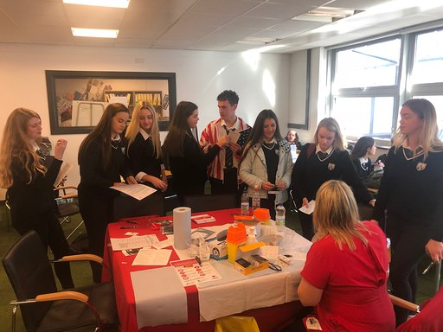
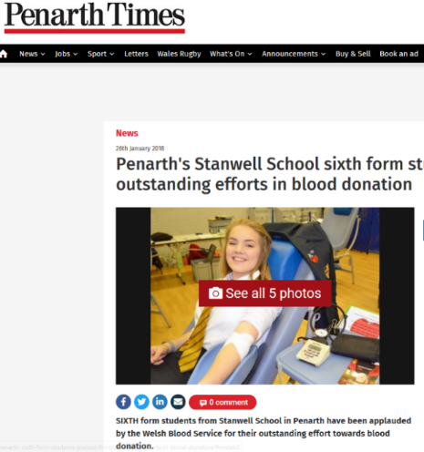
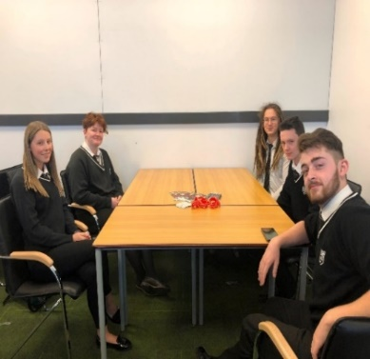
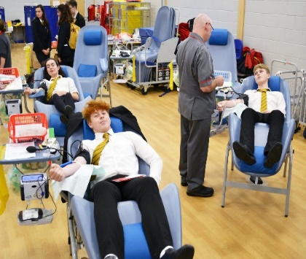
On the day…
Notes:
On the day the fantastic staff at the Welsh Blood Service will be with you every step of the way.
When you arrive you’ll be asked to drink some water.
After you complete a short quiz on the day you’ll be able to donate.
Then comes the donation!
Afterwards you’ll be able to eat biscuits and a cold drink (on the first time).
Finally – relax, knowing you’ve saved up to three lives.

Slide 13
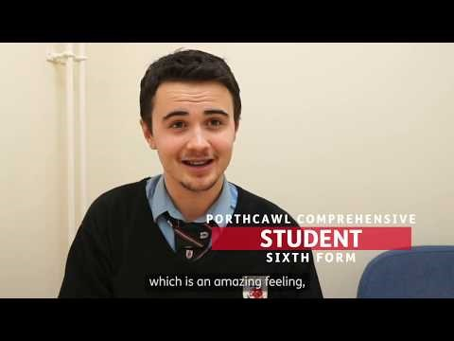
VIDEO OF PORTHCAWL PERSON

Slide 14



Benefits to giving blood
Giving the gift of life to help a patient in need
Feeling good about giving blood and supporting your community
Something great to add to your C.V

Slide 15
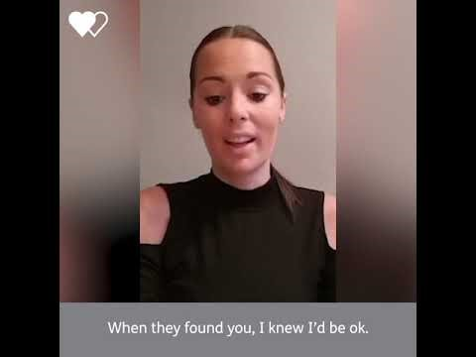
Notes:
You can also sign up to join the Welsh Bone Marrow Donor Registry!
The Welsh Bone Marrow Donor Registry (WBMDR) is a panel of blood donors who have volunteered to become bone marrow or peripheral blood stem cell donors.
The panel is searched every day to try and find donors whose tissue type is a close match to patients who need life saving bone marrow or peripheral blood stem cell transplants.
The larger the panel the greater the chance of finding a well-matched donor for a patient. The chances of a volunteer being matched with a patient varies greatly. Some volunteers can be matched after a short time on the registry and others are never called.
How do I join?
Joining the panel is simple, you can join the Welsh Bone Marrow Donor panel from the age of 17 years and up until your 31st birthday; you must be a blood donor. We will take a small blood sample from you when you next give blood, this sample will allow the WBMDR to ’tissue type’.
You can join today by enrolling online and we will ask you to give your blood sample the next time you give blood, or alternatively let us know that you would like to join the Welsh Bone Marrow Donor panel the next time you visit a blood donation session.
This is Kelly, a story of surviving cancer, all thanks to someone who joined the Welsh Bone Marrow Donor Registry.

Slide 16
Social media
Remember to follow us on

Slide 17
Questions?
Thank you for listening

