Slide 1


Everything you need to know
about giving blood!

Slide 2


About the Welsh Blood Service
Every Year…
1,600
Donation Clinics
200
Venues
100,000
Donations taken
75% South Wales
25% North Wales

Slide 3
Why donate?
75%
Medical conditions
20%
Surgery
5%
Childbirth
Every day we need around 350 donations to support our 19 hospitals in Wales.

Slide 4
How many people donate?
What percentage of eligible people living in Wales give blood?
a) One percent
c) Five percent
b) Three percent
d) Ten percent

Slide 5
How many people donate?
What percentage of eligible people living in Wales give blood?
a) One percent
c) Five percent
b) Three percent
d) Ten percent

Slide 6


Why donate?
One donation
Three lives

Slide 7
What’s in a donation?
Red cells
Platelets
Plasma
Last 35 days
Last 7 days
Lasts for 3 years
A&E
Cancers
Heavy burns

Slide 8
What’s My Type?
You will have one of four different blood types and each type has a positive and negative.
A
AB
B
O

Slide 9
What’s My Type?
O negative is the universal blood type.
Anyone in this room can receive O- blood which makes it crucial for emergencies.
O

Slide 10


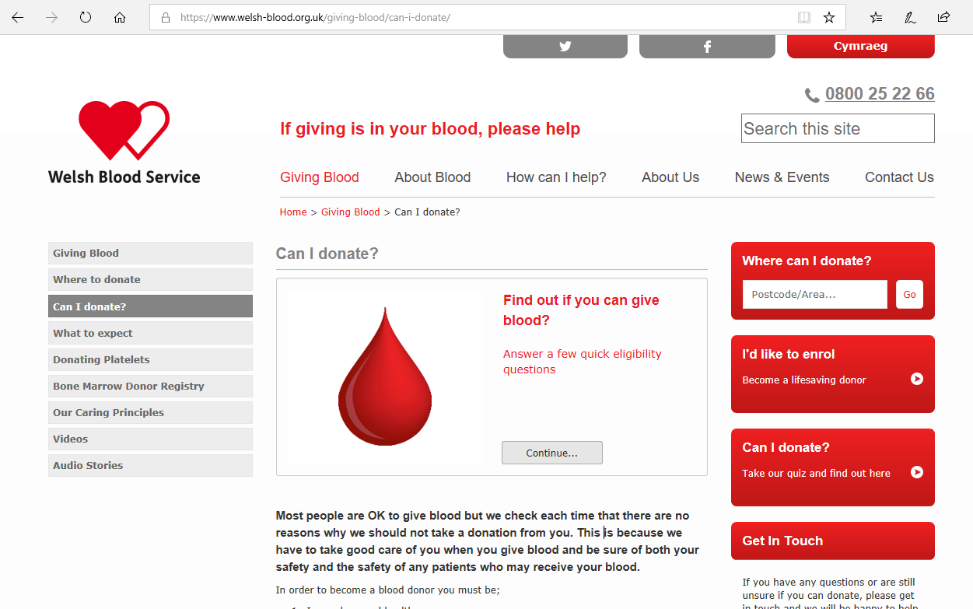

Top tips before giving blood
Eat well
Check you
can give
Stay hydrated

Slide 11



What you need to know
The whole process takes up to one hour.
Donating only takes five to ten minutes.
No time limit on the tea and biscuits.

Slide 12











What might stop you donating?
Possible deferral
Four month deferral
On the day
Meds/
conditions
Piercings
Feeling unwell
Weight
Tattoos
Not drinking
Travel
Microblading
Not eating
Dental
treatment
Lip fillers etc.
16
Aged 17+

Slide 13
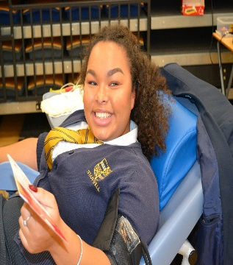
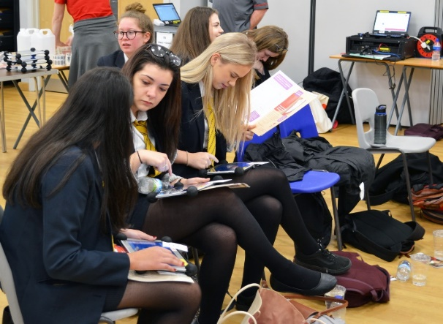

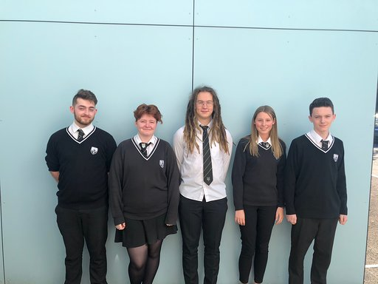
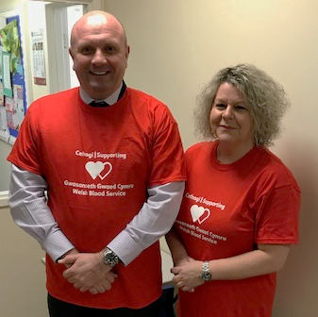
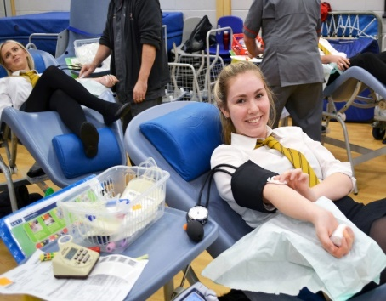
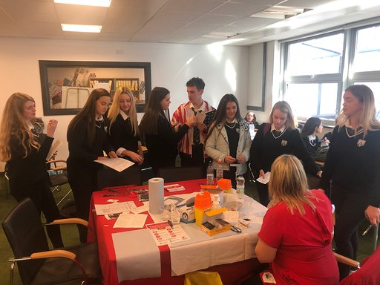
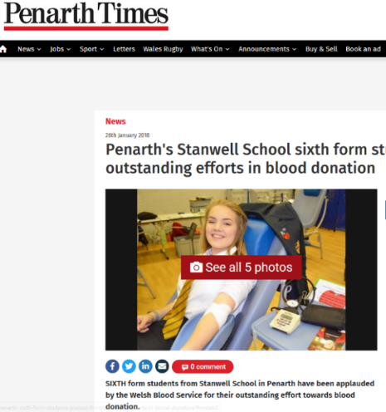
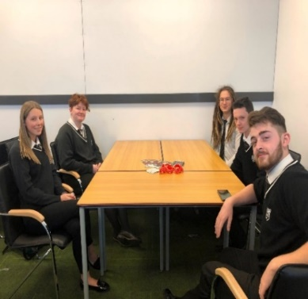
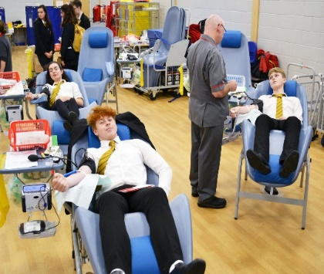
On the day…

Slide 14


Slide 15



Benefits to giving blood
Giving the gift of life to help a patient in need
Feeling good about giving blood and supporting your community
Something great to add to your C.V

Slide 16
Introducing the Welsh Bone Marrow Donor Registry

Slide 17
About bone marrow
Bone marrow is the soft, spongy tissue found at the centre of certain bones in your body where blood stem cells live.
🦴
🩸
🩺
🏥
Blood stem cells produce all your essential blood cells, such as red blood cells to carry oxygen and white blood cells to fight infection.
There are some diseases, such as leukaemia, which stop bone marrow working properly.
For these patients, the best hope of recovery is to receive a bone marrow transplant.

Slide 18
Facts and figures
Worldwide, around 40,000,000 volunteers have signed up to be a volunteer bone marrow donor.
🌍
📝
🔍
🧑‍🤝‍🧑
💔
Over 70,000 active donors are currently on the Welsh Bone Marrow Donor Registry (WBMDR) panel, with over 2,500 new donors signing up in the last year.
Every time a patient needs a transplant, the WBMDR is searched for the perfect match.
Every year, around 2,000 people in the UK and 50,000 people globally need a bone marrow transplant from an unrelated donor.
Currently only 7 in 10 people find a suitable match.

Slide 19
Thinking of joining the Welsh Bone Marrow Donor Registry?
❓
📞
❓
🖥️
Are you aged between 17 and 30? You could become a #ChilledOutLifesaver!
You remain on the Welsh Bone Marrow Donor Registry panel until your 60th birthday and may be called up as a match at any time.
Did you know there are now two ways to give your sample and join the register?
  Via a sample from your blood donation 🩸
  Or requesting a cheek swab kit 💌
For further information on how to register as a volunteer bone marrow donor visit: wbs.wales/bonemarrow

Slide 20
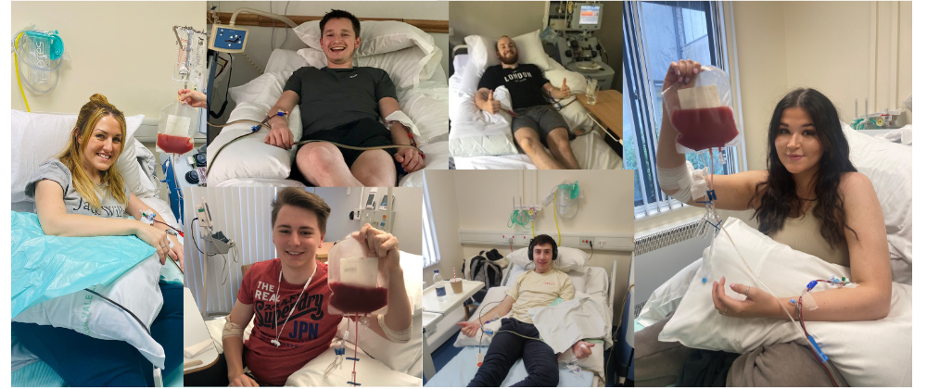
Some of our incredible #ChilledOutLifesavers

Slide 21


Slide 22
Social media
Remember to follow us on

Slide 23
Questions?
Thank you for listening

